Slide 1
The Neptune Brothers Amazing Places

Slide 2
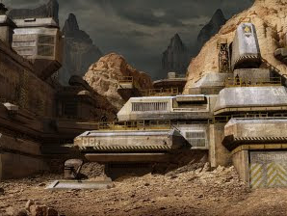
Venus Military Base
This is the place where the Venus soldiers receive training and where they make their weaponry and prepare for battle.

Slide 3

Neptune Military Base
Neptune’s military base looks like a mountain, but inside the mountain is a military base full of weaponry and vehicles. Here they prepare for battle.

Slide 4
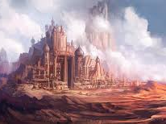
Venus castle
This is where the king, queen, and the Venus brothers live.

Slide 5
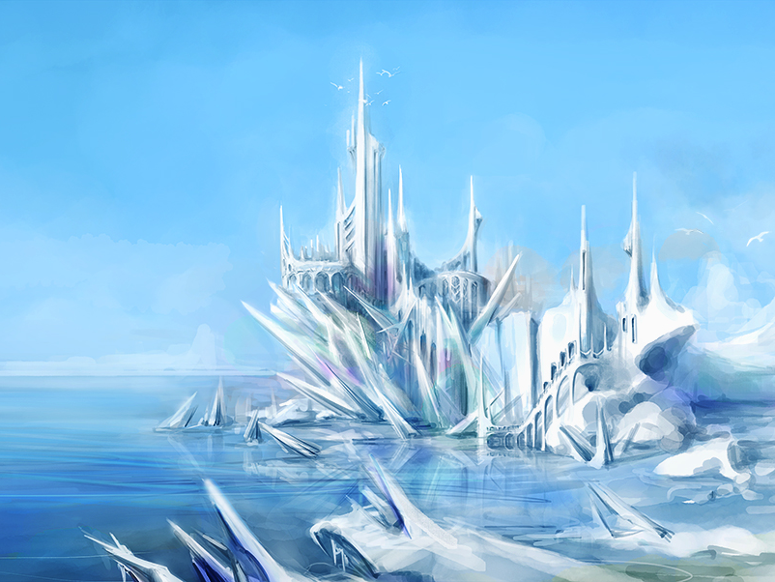
Neptune castle
This is where the king, queen, and the Neptune brothers live.

Slide 6
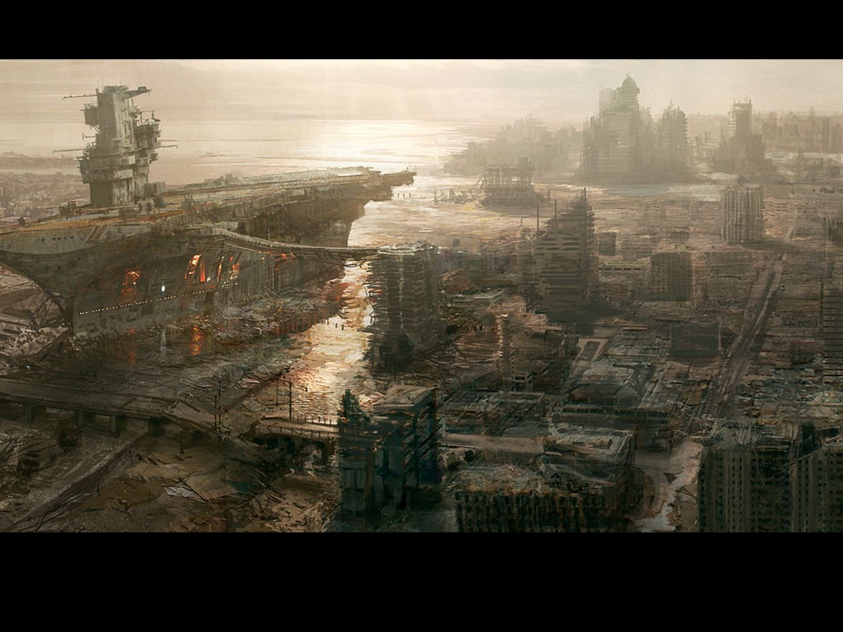
Pluto
This is Pluto when Skeetha ruled the galaxy. The ship you see is actually a space ship full of slaves throughout the galaxy. It is piloted by one of Skeetha’s most loyal and powerful slaves.

Slide 7
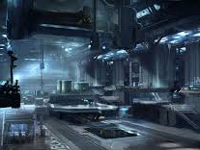
Neptune’s Laboratory
This is the place where Professor Aid’an built the 2 suits that he and Eth’an, his twin, used to defeat Skeetha.

Slide 8

Neptune Energy Prison
This is the place where the suits of armor that Aid’an built were kept. It’s made of nearly indestructible cosmic energy so enemies can’t get in and steal it. The only way someone could get in is if they shut the energy prison down by scanning your hand against the scanner and it will see if you have the same D.N.A. code as King or Queen Neptune and if you don’t the security system will engage. You could also shut it down if you say 16dash5790 in the same voice pattern as Professor Henry Fields, the machine’s creator.

